Slide 1
HVAC System
For heating, ventilation and air conditioning system

Slide 2
UML Class Diagram

Slide 3
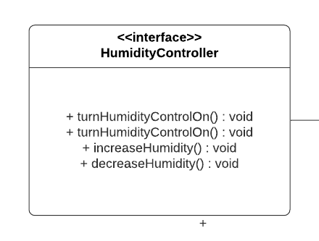
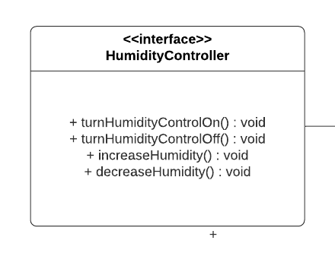
HumidityController

Slide 4
HumidityController
Turns Humidity Controller On
Turns Humidity Controller Off
Decrease Humidity by 1%.
Increases Humidity by 1%.

Slide 5
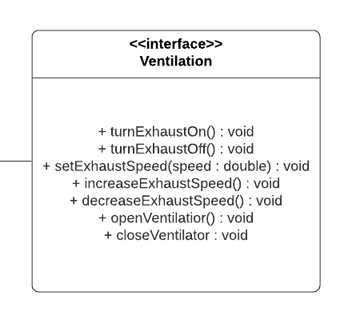
Ventilation

Slide 6

Ventilation
Turns Exhaust On
Turns Exhaust Off
Increase exhaust speed by 1 rpm
Decreases exhaust speed by 1 rpm
Open all the Ventilators
Close all the Ventilators

Slide 7
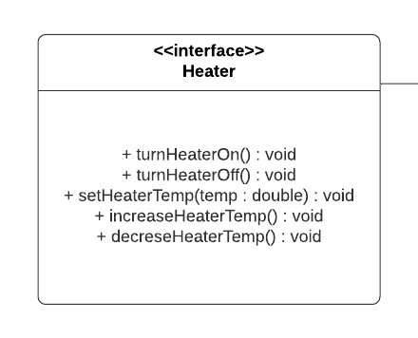
Heater

Slide 8
Heater
Turns heater on
Turns heater off
Increases the temp of the heater
Sets the temp of the heater
Decreases the temp of the heater

Slide 9
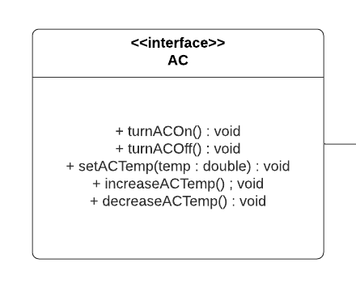
AC

Slide 10
AC
Turns AC on
Turns AC off
Sets AC temp.
Increases AC temp. by 1 °C
Decreases AC temp. by 1 °C

Slide 11
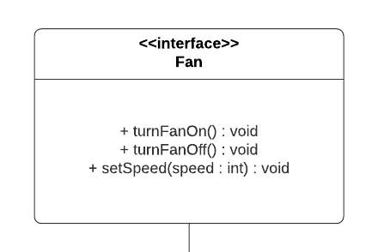
Fan

Slide 12
Fan
Turns fan on
Turns fan off
Sets the speed of the fan

Slide 13
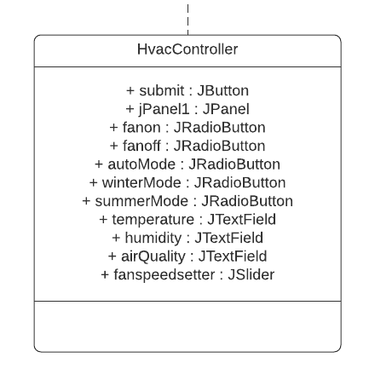
HvacConroller

Slide 14
HvacConroller
Button for submitting the data to the other screen
Radio button group for turning fan on or off
Radio Button group for selecting the modes of HVAC System
For entering temp., humidity and air quality level
For setting the speed of the fan

Slide 15
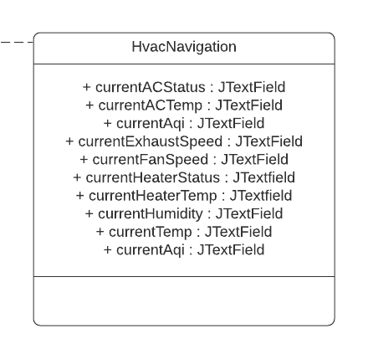
HvacNavigation

Slide 16
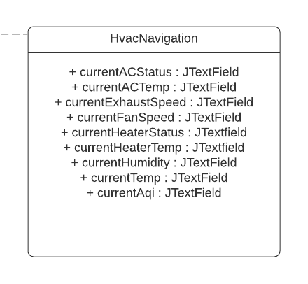
HvacNavigation
For displaying the information about AC
Displays current exhaust speed
Displays current fan speed
For displaying current humidity, temp. and aqi level after the necessary actions are taken
For displaying information about heater

Slide 17
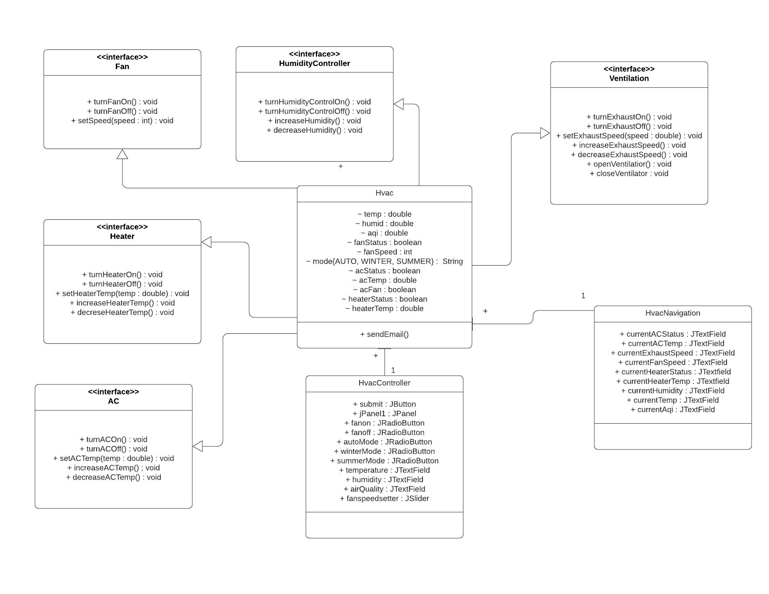

Slide 18
UML state diag

Slide 19
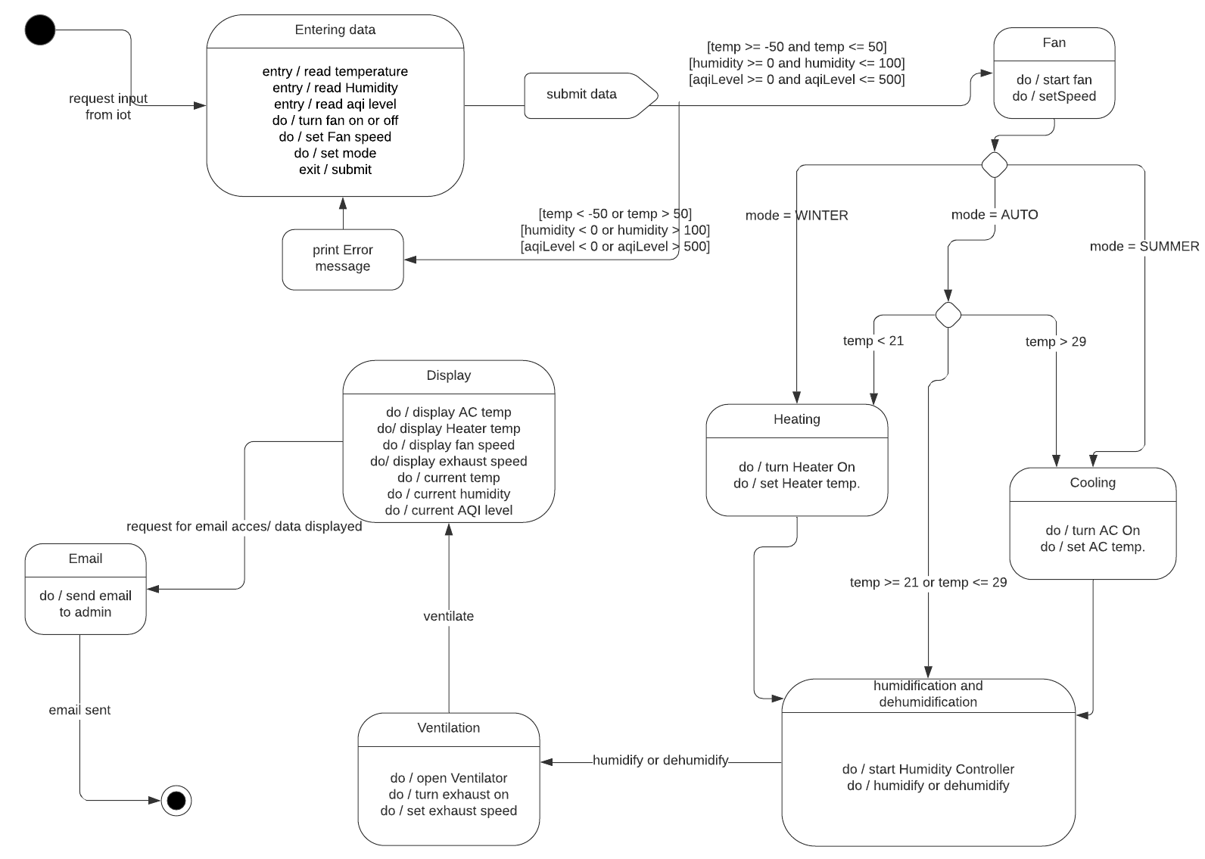

Slide 20
GUI HVAC SYSTEM

Slide 21
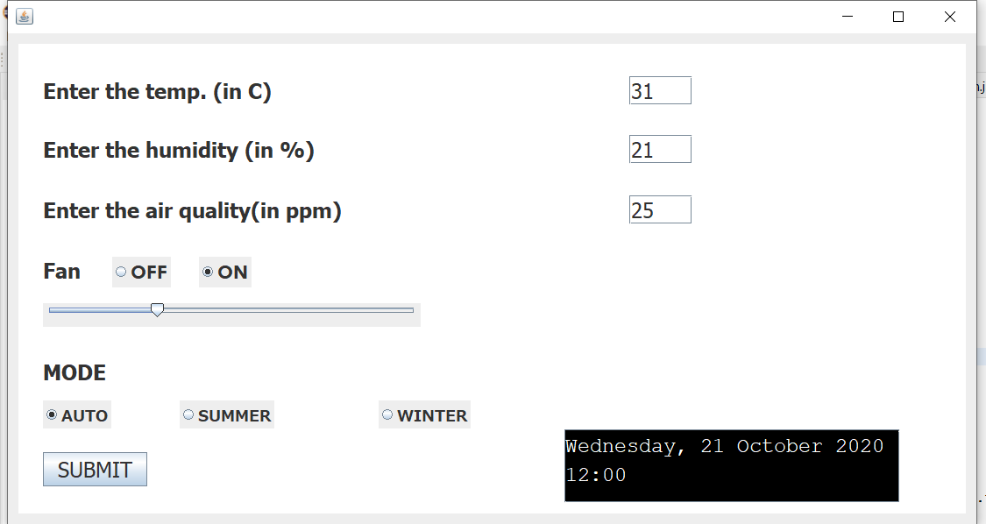
HVAC Controller

Slide 22
Slider for setting speed of fan
For entering temp
For entering humidity
For entering aqi level
Submit button to send data to navigation panel
Calendar and time

Slide 23
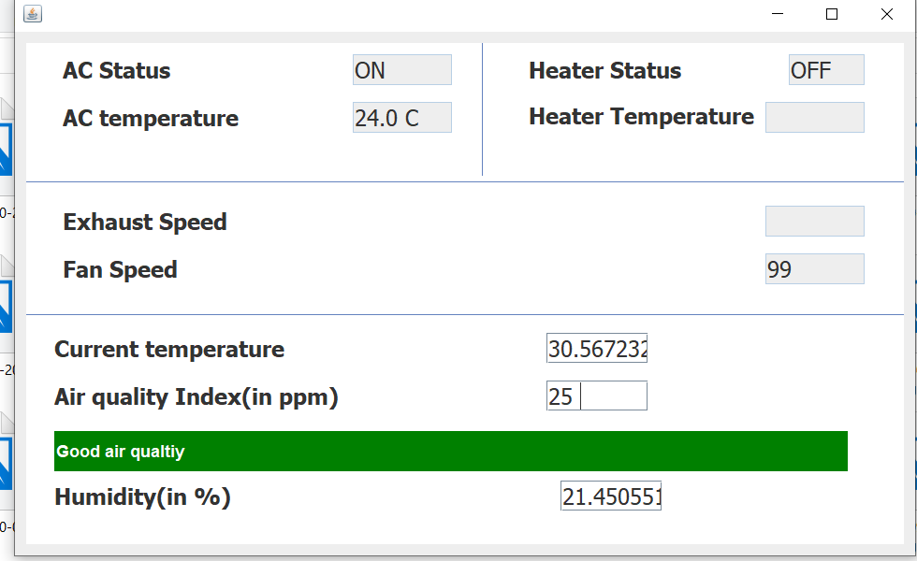
HVAC Navigation

Slide 24
Heater Information
AC information
Message box regarding air quality

Slide 25
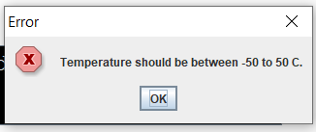
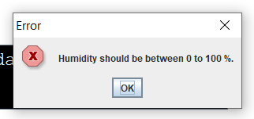

Error Dialog

Slide 26
Thank You
IIT2019121 IIT2019140 IIT2019181 IIT2019182
Gurmeet Sagar Prathamesh Ekansh

